Slide 1
Psychopharmacology
Dr Jaz S Phull
Consultant Forensic Psychiatrist & Clinical Director, LPFT
Hon. Senior lecturer, University of Lincoln

Slide 2
Aims of workshop
What you don’t need to know -
everything about complexities of neurology, neurotransmitters and brain and psychotropics
Hopefully..
a broad understanding of how medications impact on the brain;
an understanding of the further impact this will have on psychological functioning;
a questioning position in relation to use of medications within mental health;
a willingness to consider these issues in your place of work in relation to your clients;
An understanding of the range of psychopharmacological interventions

Slide 3
Introduction
Definitions and context
Neuroanatomy
Pharmacokinetic principles
Classification of psychotropic medications
Adverse effects
Critical paper review
What does a psychologist need to know

Slide 4
Definitions
Whats your definition of psychopharmacology?
The scientific study of the effects drugs have on mood, sensation, thinking, and behaviour.

Slide 5
Legal context
“Medical treatment for mental disorder means medical treatment which is for the purpose of alleviating, or preventing a worsening of, a mental disorder or one or more of its symptoms or manifestations”
“….medical treatment includes nursing, psychological intervention and specialist mental health habilitation, rehabilitation and care”
MHA 2007

Slide 6
Historical context
In the 1950s, Thorazine introduced to manage ‘shock’ after WWII - beneficial nausea and sedative effect
Imipramine - 1957
Lithium & monoamine hypothesis- 1960s
Introduction of SSRIs 1980s
Second generation antipsychotics 1990s+

Slide 7
Your experiences and thoughts..
What have you observed in relation to use of medication on psychological functioning?
Discuss in pairs and share experiences

Slide 8
Is psychopharmacology helpful?
Quantifiable - and studied more systematically
Act quickly to reduce systematic distress
Not reliant on individual skill such as psychotherapy
Rapid & effective symptom relief, can enable psychotherapy
Can be helpful when psychotherapy is inappropriate
Not prolonged and expensive and available

Slide 9
Unhelpful?
Only psychotherapy can address the complexity of human psychologically functioning.
Aimed towards personal growth and autonomy - medications create dependency
Free will effected
Medications may reduce distress so that people are less motivated to engage in psychotherapy
Side effects
Do not solve problems, teach coping, or fill empty lives
Stimulus response specificity

Slide 10
Psychodynamics of pharmacological treatments
Prescribing always occurs in an interpersonal context, that may alter the therapeutic relationship
Generic narratives: “taste of his own medicine”; sickness; therapeutic failure; “weak willed” and addictive therapy
An “assault on free will” or “chemical straightjackets”
Individuals with various mental health problems will view medications differently
“Resistance” i.e. avoidance of psychotherapeutic processes
Countertransference-reactions through therapy endings, legitimising ongoing therapy
Cultural responses - experiences and pharmacokinetics

Slide 11
Neuroanatomy

Slide 12
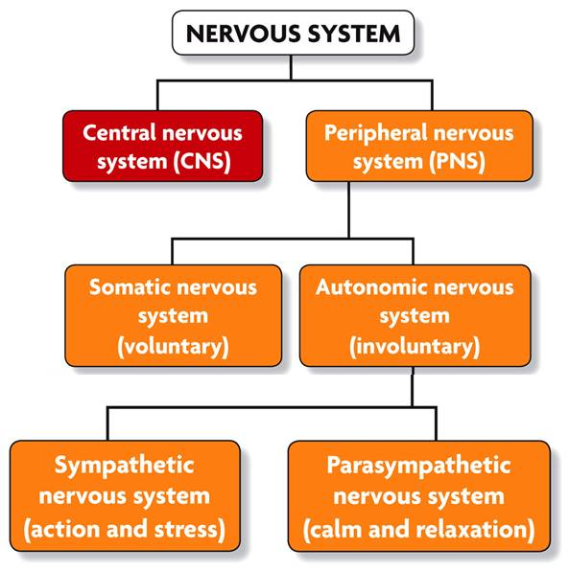
Nervous system
CNS – brain and the spinal cord
PNS – spinal nerves that branch onwards

Slide 13
Brain
Cerebrum – largest component divided by the corpus callosum; 4 lobes.
Cerebellum – 2 hemispheres: coordination
Brainstem – medulla, pons and midbrain
Notes:
Medulla: breathing and HR
Pons: sensory analysis, maintenance of posture and movement
Midbrain: regulation of motor function

Slide 14
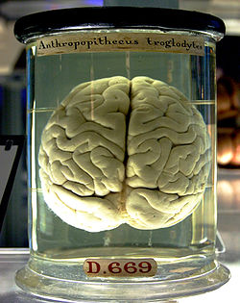
Brain
Cerebral Cortex contains 15-33 billion neurons linked with 100,000 synaptic connections.
Neurons communicate with each other by means of axons
Axons carry signals of pulses called action potentials (APs) across the brain

Slide 15
Structural aspects
Meninges:
1. Pia mater – innermost layer
2. Arachnoid layer – thin layer holding CSF
3. Dura Mater – outer layer
CSF:
Produced in the choroid plexus
Immerses the brain as a mechanical & immunological barrier plus carries products

Slide 16
Meninges

Slide 17
CSF/ Choroid plexus

Slide 18
Functional systems
Sensory systems
Function of the brain to extract relevant information from senses
Motor Systems
Production of movement
All voluntary muscles have neurons projecting into the spinal cord
Arousal systems
Arousal and alertness modulated by an extensive network of brain areas

Slide 19
Nervous system
2 types of cells:
Glial – support functions
Neurons – signalling and communicating consisting of dendrites, soma and axons
Notes:
Soma: contains important cellular components and is the metabolic cnetre of the neuron
Dendrites: branched extensions receiving nerve signals & form the postsynaptic terminal of a synapse
Axon: single long fibres extending from the soma- presynaptic neuron receivning information. Myelin sheath coated.

Slide 20
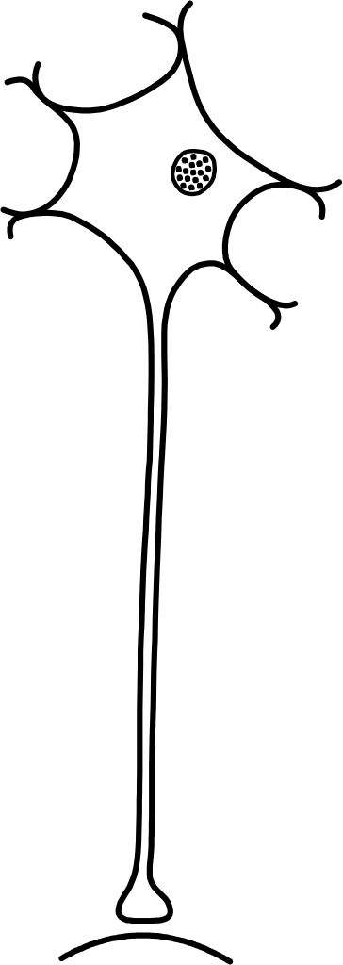
The neurone
cell body (soma)
dendrites
action potential
(impulse) generation
axon
action potential
conduction
presynaptic
terminal
synapse
postsynaptic
membrane
synaptic
transmission
Notes:
Soma: contains important cellular components and is the metabolic cnetre of the neuron
Dendrites: branched extensions receiving nerve signals & form the postsynaptic terminal of a synapse
Axon: single long fibres extending from the soma- presynaptic neuron receivning information. Myelin sheath coate

Slide 21
Synaptic gap

Slide 22
Resting and Action Potentials
RPs: Intracellular –ve resting potential in the nucleus (more Na+ outside)
APs: Opened voltage gated channels – Na+ floods in. Increased +ve charge –> depolarization. When a threshold is reached –> neuronal firing.
Several drugs alter these voltage gated channels
Alcohol inhibits by blocking excitatory channels on the post synaptic neurons.
Notes:
Resting potential
Action potential

Slide 23
Neurotransmitters
NTs – responsible for transmission of nerve impulses
Transmission –neurons and target cells via a synapse
Types of neurones defined by their neurotransmission
3 aspects: making; storing and releasing it
Either small molecule NTs or neuropeptide NTs
Notes:
NTs – endogenous chemicals

Slide 24
NT systems: basic principles
Neurons release same neurotransmitter (Dale’s principle)
Most common neurotransmitters are Glutamate & GABA
Drug actions alter neurotransmitter systems across the brain (via Glutamate & GABA) and in specific areas (e.g. Prozac targeting Serotonin)
These neurotransmitters can be found in almost every part of the brain
However, there are also many other transmitters involved in relaying information in the brain

Slide 25
NT: basics
There are also many localised neurotransmitters
Serotonin: primary target of antidepressant drugs comes exclusively from a brainstem area called Raphe nuclei
Norepinephrine: involved in arousal comes exclusively from a small area called the locus ceruleus
Other neurotransmitters such as acetylcholine & dopamine have multiple sources in the brain but not as ubiquitously distributed as glutamate and GABA

Slide 26
Synaptic actions
Vesicle merging with
presynaptic membrane and
NT release
Influx of impulse
creates movement
across axon
https://www.youtube.com/watch?v=p5zFgT4aofA

Slide 27
Main neurotransmitters
AcetylCholine (ACh)- regulate muscle movement- found all over the CNS.
Various functions –pain, NE regulation, REM, memory and learning.
Alz D associated. Muscarinic and Nicotinic ACh Receptors.
Notes:
NE - neuroendocrine

Slide 28
Norepinephrine (NE) – “fight or flight” – HR, circulation and respiration- triggered as a sympathetic response. Metabolised by COMT and NET is responsible for reuptake of extracellular NE.
NET is a target of many antidepressants and decreased quantities noted in ADHD
Beta-1 receptors facilitate release of NE
Notes:
COMT: catechol-o-methyltransferase
NET: NE transporter
NE or NA

Slide 29
Dopamine (DA): 2 main transporters (DAT) and (VMAT).
The main enzymes involved in metabolising DA are MAO and COMT. – targets for medications.
Deficiency – Parkinsonism and Excess - Schizophrenia
Various D1-D4 receptor sites
https://www.youtube.com/watch?v=2uBuHcFspeA
Notes:
DAT – transport to outer cell to into the cell
VMAT – reloading DA back to the vesicles
MAO – monoamine oxidase
COMT – catechol-o methyl transferase

Slide 30
Serotonin (5HT): important for mood, appetite, sleep, cognition and blood coagulation.
Antidepressants inhibit reuptake – inhibiting serotonin reuptake into the presynaptic vesicle.
Metabolised by MAO
https://www.youtube.com/watch?v=G4r3qCkLUDQ

Slide 31
Glutamate (Glu): An excitatory neurotransmitter. Brain injury often results in excess release into the extracellular space.
A 2013 study – excess Glu – precursor to psychosis in a high risk population. Levels may be prodromal to full development.
Notes:
It is a neuropeptide

Slide 32
GABA – a inhibitory NT, synthesised by Glu decarboxylase and transported via vesicles through transporters.
Reuptake by membrane transporters into neurons where recycled by their enzymes.

Slide 33
Psychopharmacology: basics

Slide 34
Basics
Pharmacokinetic actions – body on drug
Pharmacodynamic actions – drug on body
Drug gets into body &
reaches site of action
Drug acts to produce
Its effect on the body
Drug leaves
the body
Pharmacokinetics
Pharmacodynamics
Pharmacology
Beneficial or harmful
Therapeutics

Slide 35
The Blood Brain Barrier
Psychotropic medications are both hydrophobic (build up) and hydrophillic (through membrane) in nature – accounting for speed of action.
They need to be lipid (fat) soluble to get to the brain via the blood brain barrier.

Slide 36
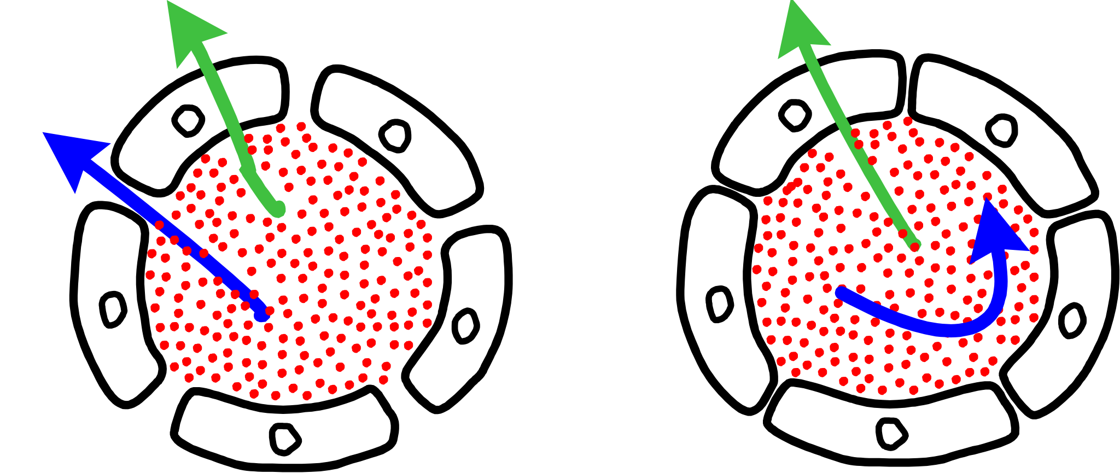
The Blood Brain Barrier
Ionized (lipophobic) drug molecules cannot easily pass through
capillary walls in the CNS
Non-ionized lipophilic drug molecules generally have ready access
to the CNS
B
B
A⁺
A⁺
capillary in the periphery
capillary in the brain

Slide 37
Pharmacokinetic principles
Absorption – drug into blood circulation, the blood brain barrier limits medications into the Brain. Routes affect absorption (IV>IM>orals).
Distribution – Once entered the blood stream, the drug is spread inside and outside the cell. Affinity, lipid solubility & protein binding affect distribution as cannot pass through the BBB.
Metabolism – Breakdown of the medication, often in liver via “first pass metabolism”. Enzyme induction/inhibition is important.
Elimination - majority of drugs excreted by kidney; acidic urine is good for the excretion of basic drugs (TCAS, AMPHETAMINES) and acidic drugs are passively reabsorbed.
Notes:
Absorption – enteral – via gut
Paraenteral – from sites other than gut –IM/Sc/IV etc
Drug absorption – effected by the form of drug (coating), solubility of the drug, and rate of blood flow at the site of administration
Distribution – spread across lipid, protein and water compartments- ‘free’ non bound fraction pharmacologically active
Metabolism – first step is oxidation then conjugation (phase I- II- making it water soluble) and metabolism can occur in other areas too – skin/kidneys/GI/lungs etc
Elimination – exclusion from the body

Slide 38
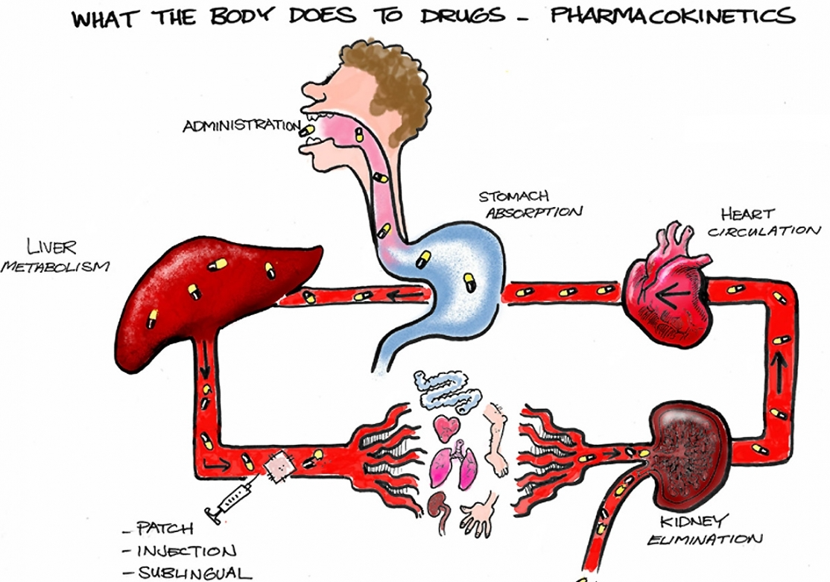

Slide 39
Blood concentration
Either:
Zero order kinetics - a constant amount of drug is cleared in unit time & elimination has reached saturation e.g. alcohol
First order kinetics - constant fraction of the drug is cleared per unit time (most drugs)

Slide 40
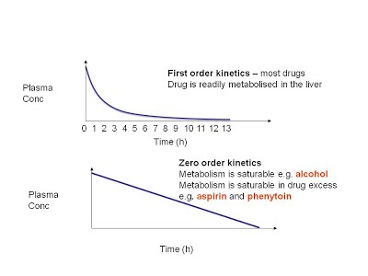

Slide 41
Volume of distribution (Vd)
Apparent distribution volume
Loading dose reqd = Dose concentration / Vd.
The lower the Vd, the more protein bound, reduced lipid solubility, longer the duration of drug action..
Bioavailability = the amount of drug that enters circulation when intro’d to the body & has an active effect.
Half life and steady state after 5 x t1/2
Notes:
How much wil stay in blood vs how much will distribute in tissues (i.e. be active)
Paracetamol = 20mg/l fro headache Rx and Vd = 50 litres
How much do we need?

Slide 42
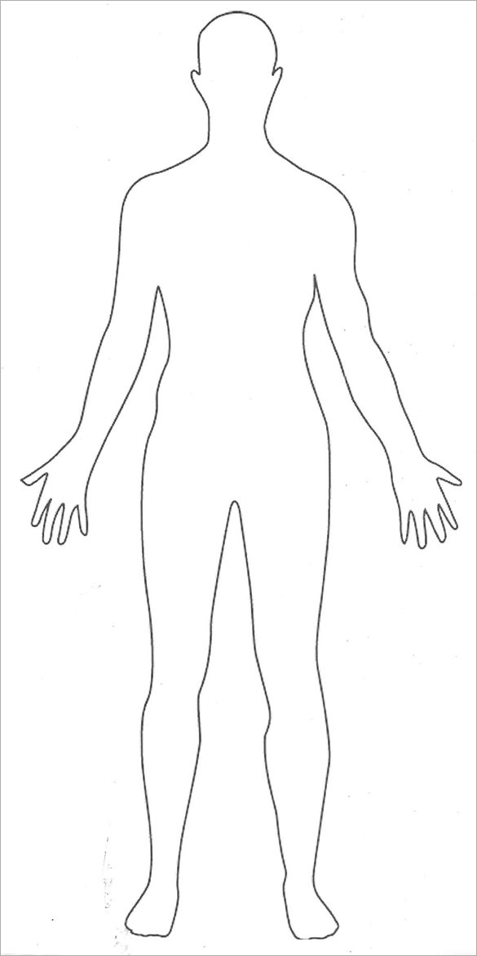
20mg/l paracetamol (meds concentration)
Volume of distribution = 50L
How much of a dose do we need?
Remember
Loading dose =
Volume of distribution x meds concentration

Slide 43
Acetylcholine (Ach) – Alz, learning, memory and movement
1. basal ganglia
2. cerebral cortex
3. basal nucleus of Meynert
Dopamine (DA) – behaviour, emotions and movement
1. tuberoinfundibular (c.f. Prolactin secretion)
2. mesocorticolimbic (c.f. Schizophrenia)
3. nigrostriatal (c.f. Parkinson’s)
4. ventral tegmental area (reward; motivation)
Serotonin (5-HT)- impulsivity, aggression, depression and food intake
1. brain stem - raphe nucleus, pons 2. cerebral cortex
3. limbic system
Noradrenaline (NA) – arousal, attention and memory
brain stem - locus cereuleus 2. reticular activating system
GABA - sleep and anxiety
1. cerebral cortex 2. striato-nigral
Opiate (Op) – pain relief
1. periaquaductal grey matter
Glutamate (Glu) – long term memory
1. cortex and striatal pathways

Slide 44
Pharmacodynamic actions
Is the activity of the drug on body tissues
Medications act as either agonists (receptor binders) or antagonists (receptor blockers), by inhibiting enzymes or blocking stimulators of neurotransmitter membrane transporters
Notes:
Drugs bound by
1. enzymes, 2. membrane carriers, 3. Ion channels, 4. Receptors

Slide 45
Receptor types
IONOTROPIC RECEPTORS
The receptor is directly coupled to ion channels in the cell membrane
ion channel
2. METABOTROPIC RECEPTORS
Receptor activation initiates a metabolic ‘cascade’ culminating in opening or closing of ion channels
ion channel
enzyme
2nd messenger
Notes:
Affinity = the strength of the association between the receptor and the binding site of the receptor. The closer the fit the stronger the response

Slide 46
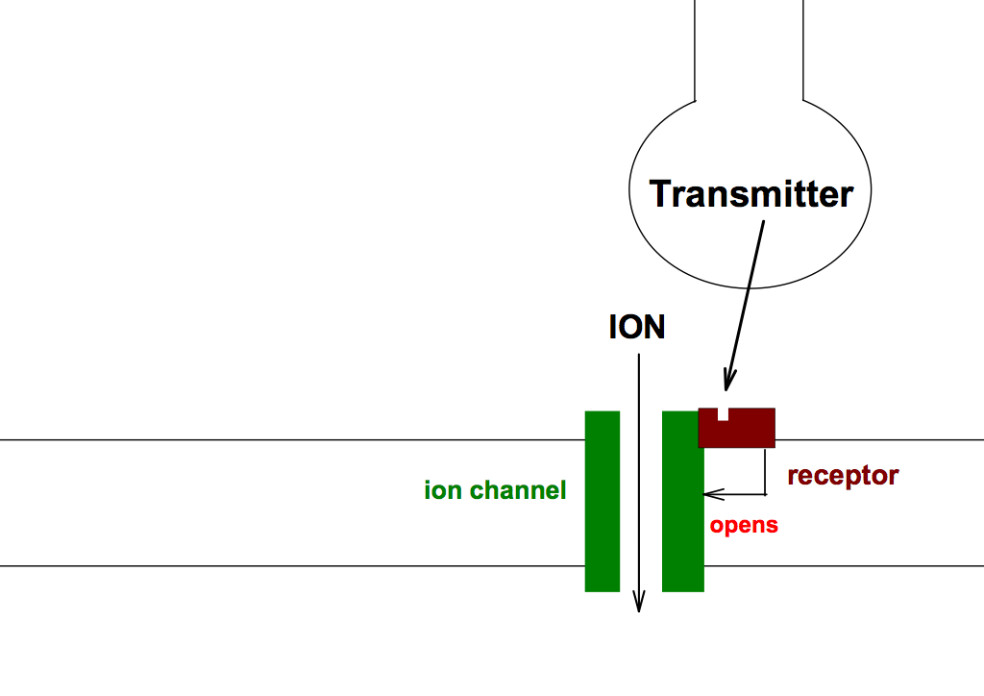
IONOTROPIC RECEPTORS
IONOTROPIC RECEPTOR

Slide 47
METABOTROPIC RECEPTOR
adenylyl cyclase:
converts ATP to cyclic AMP (2nd messenger)
phospholipase-C:
converts phosphatidylinositol to inositol
trisphosphate and diacylglycerol (2nd messengers)
Transmitter
ION
ion channel
receptor
opens
second
messenger
metabolic
cascade

Slide 48
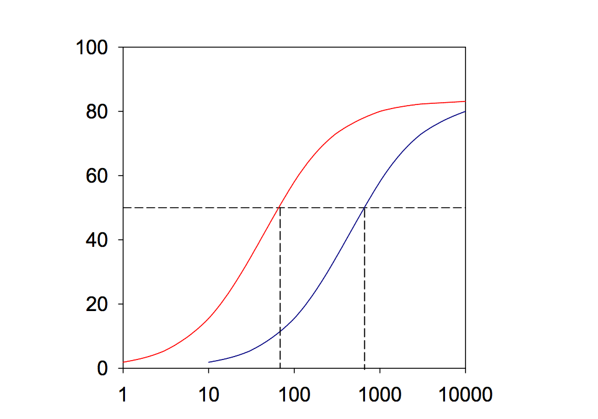
PHARMACOLOGICAL ANTAGONISM
An antagonist has no physiological effect of its own, but it blocks the
effect of an agonist
AGONIST
ANTAGONIST
= ACTION

Slide 49
REGULATION OF NEUROTRANSMITTER FUNCTION
Autoreceptors
Receptors on neuronal membrane that respond to the neurone’s own transmitter
Release modulating: negative feedback
Receptor adaptation
Excessive stimulation downregulation (desensitization)
Insufficient stimulation upregulation (supersensitivity)

Slide 50
Common drug-receptor complexes
Specificity: binding affinity
Receptor occupation: competitive antagonists “block” receptors, reducing excitatory action
Receptor structural change: altering the receptor protein to create an effect
Receptor population: the number influences drug response.
Notes:
Reversible or irreversible changes
Upregulation (incr no. of rcs in the absence of agonists)/downregulation responsible for drug desensitisation (tolerance)

Slide 51
Receptor actions
Withdrawal syndrome: discontinuation of receptor activation after continued use
Rebound effect: return of symptoms that were previously under control – when an agonist is abruptly withdrawn
Tolerance: During continued use of a drug, tolerance (functional desensitization) may develop to therapeutic and/or side effects of the drug.

Slide 52
Different types of psychotropic medications
Antidepressants
Antipsychotics
Anxiolytics
Mood stabilisers
Prescription stimulants
Cognitive enhancements
Sedative hypnotics
Miscellaneous

Slide 53
Psychopharmacological treatment plans
Acute resolution of episode
Longer term symptom control
Improvement of quality of life
NB drug-drug interactions

Slide 54
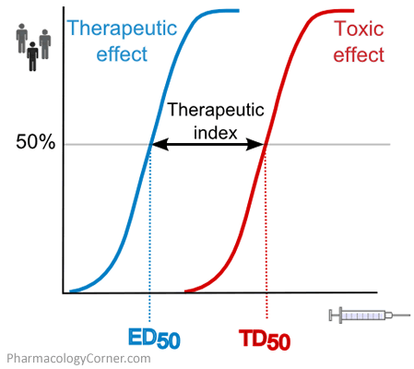
Dosing
Therapeutic index (TI)
Threshold
Effective dose
Toxic dose
Ti = ED50 / TD50
A wider Ti better
If patient is suicidal

Slide 55
Specific medication types

Slide 56
Antipsychotics

Slide 57
Antipsychotics
Used for psychosis, bipolar disorder, nausea, ASD and Tourette’s
Atypical and typical versions, with different pharmacological profiles
Clozapine is an example of an atypical
Side effects: EPS, CVS, sedation, weight gain, hypotension, metabolic and hormonal.
Physical health monitoring important
Notes:
Differences relate to MOA – typical D2 blockade & atypical = variety/ D4
Typical – eg. haloperidol

Slide 58
Antipsychotics: schizophrenia
NICE emphasises patient choice: tolerance, and response key
FGAs work on D2 blockade
SGAs often act at D2 and 5HT2A and 2C
Newer SGAs work this way, but have “partial affinity” and partial blockade effects i.e. more selective
Notes:
Sit tight, increase dose, augment, clozapine

Slide 59
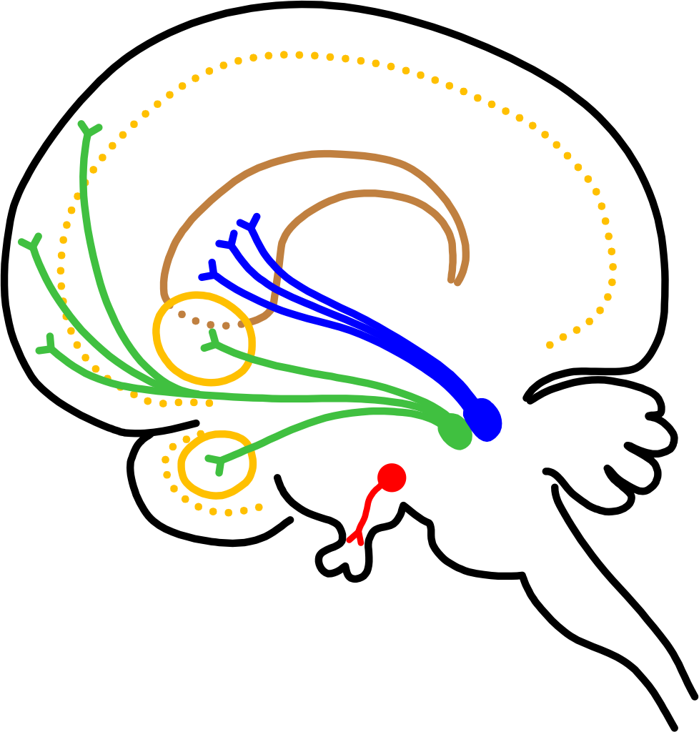
Dopamine pathways
NIGROSTRIATAL
PATHWAY
CORPUS STRIATUM
MESOLIMBIC/
MESOCORTICAL
PATHWAYS
SUBSTANTIA NIGRA
CORTEX
N. ACCUMBENS
AMYGDALA
VENTRAL TEGMENTAL AREA
TUBERO-INFUNDIBULAR
PATHWAY
HYPOTHALAMUS
PITUITARY STALK
https://www.youtube.com/watch?v=2uBuHcFspeA

Slide 60
Efficacy
CATIE and CutLASS studies reviewed evidence relating the the efficacy of 51 FGAs and 11 SGAs.
Minimal advantage of SGAs over FGAs other than anticholinergic side effects and EPSEs
When individual SGAs compared*, olz > aripiprazole, risperidone, quetiapine and ziprasidone.
Depots are often considered advantageous
Clozapine is preferred after two failed trials of treatment (NB augmentation)
Notes:
First generation antipsychotics
*non clozapine
*Vs FGA – Risp, olz, amisulpiride thought to be more efficacious
FGAs reserved for 2nd line due to TD/ movement disorders

Slide 61
Reasons for non or partial response
Drug use
Cytochrome polymorphisms (enzyme change)
Psychosocial stressors
Incorrect diagnosis
Non compliance
Medication interactions

Slide 62
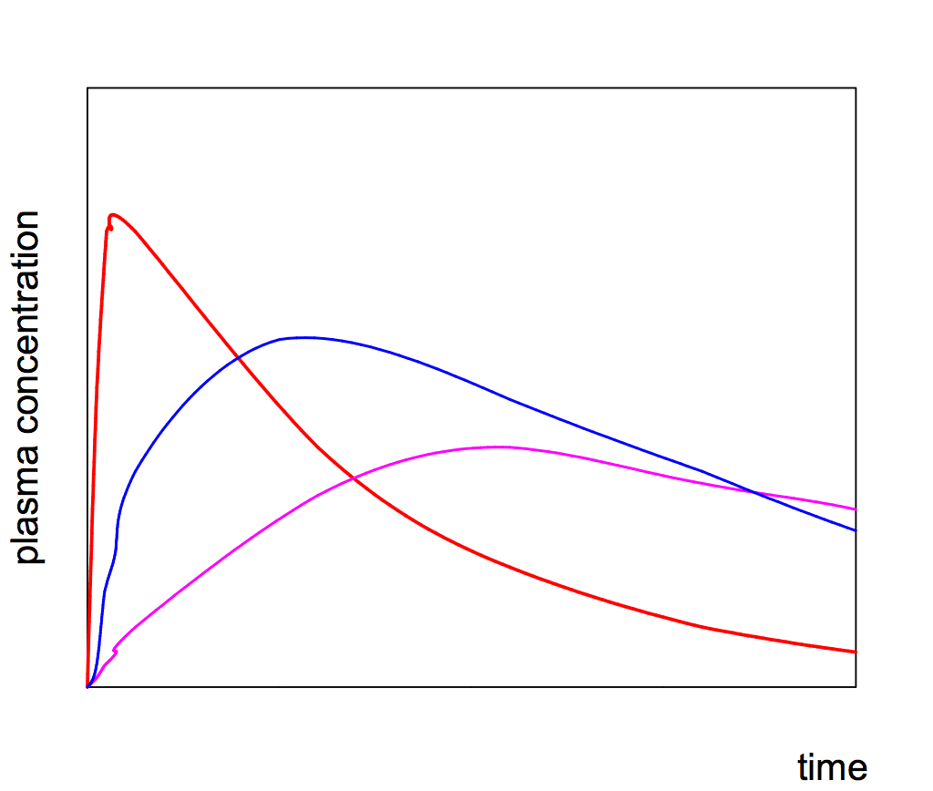
ROUTE OF ADMINISTRATION
INTRAVENOUS
INTRAMUSCULAR
ORAL
Oral route:
slowest absorption into circulation
absorption may be affected by food in the alimentary canal
first-pass metabolism in the liver

Slide 63
Side effects
EPS - based on D2 receptor occupancy
CVS - potential QTc changes
Sedation - Histamine blockade
Weight gain - H1; 5HT1
Hypotension - alpha adrenergic
Metabolic - weight gain
Hormonal - prolactin production
Haematological - esp. clozapine; NMS
Seizure threshold effects

Slide 64
Antidepressants

Slide 65
Antidepressants
There are different classes of antidepressants
Anxiety, OCD, depression, eating disorders, dysthymia and negative symptoms
Presynaptic reuptake inhibition; inhibit synaptic MAO or blockade of presynaptic reuptake of noradrenaline or serotonin
Side effects: EPS, anticholinergic, histamine, autonomic, haematological and others.
Notes:
Extrapyramidal side effects

Slide 66
Types of antidepressant
SSRIs – stop reuptake of 5HT into the synaptic cleft (e.g. prozac)
Noradrenaline reuptake inhibitors – stops reuptake of NA (e.g. raboxetine)
Noradrenaline and specific serotenergic antidepressants – block alpha 2 adrenergic receptors – increasing 5HT and NA (mirtazepine)
Serotonin NA reuptake inhibitors – dual blockade (venlafaxine)
TCAs – block NA and 5HT but also work at other receptor sites – (amitryptiline)
MAOIs – inhibit MAO that is used to degrade 5HT and NA (phenelzine)
Notes:
Alpha 2 autoreceptor inhibits – when blocked- increases the quantity of NA and 5HT
More specific – the less side effects
NASSA used after SSRI is unsuccessful
MAO A and B – B used for dopamine in parkinsonism

Slide 67
Efficacy
NICE advocate the use of antidepressant medication for depression for moderate-severe depressive episodes.
Also OCD; PTSD; anxiety and eating disorders

Slide 68
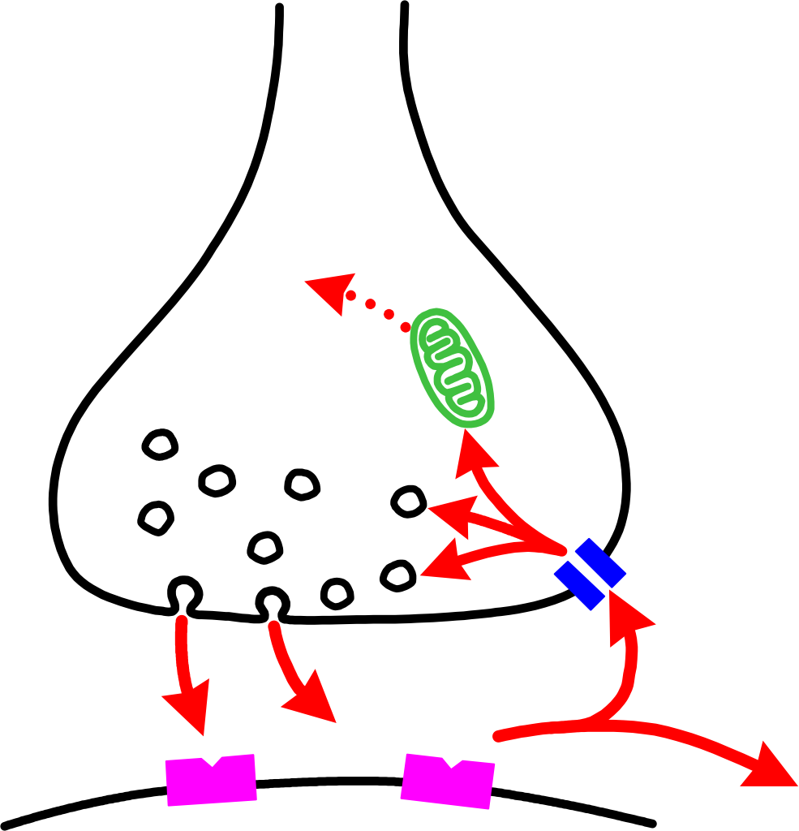
MAOIs
MAOIs block the degradation of noradrenaline (NA) and 5-HT by MAO-A
Increased concentration of transmitter in terminal increased receptor stimulation

Slide 69
Reuptake inhibitors
MONOAMINE
TRANSPORTER
(uptake site)
UPTAKE
INHIBITOR
X
Uptake inhibitors block the re-uptake of monoamine transmitters into nerve terminals.
increased concentration of transmitter in synapse increased receptor stimulation
TCAs block NA and 5-HT uptake
SSRIs block 5-HT uptake
NARIs block NA uptake
https://www.youtube.com/watch?v=ocSptPUBbuo

Slide 70
Use of antidepressants
MAOIs
Rarely used as first-line treatment of depression
May be helpful in some anxiety disorders and ‘atypical depression’
TCAs
Moderate/severe depressive illness, anxiety and OCD
SSRIs and SNRIs preferable, due to better side-effect profile
In low doses, used to manage chronic pain and sleep
SSRIs (also SNRIs)
Moderate/severe depressive illness
Some anxiety disorders (especially panic disorder and OCD)
PTSD
N.B delayed onset of therapeutic action (usually 2-4 weeks)

Slide 71
Typical side effects of antidepressants
TRICYCLICS
Dry mouth, urinary hesitancy, constipation, erectile dysfunction, blurred vision, weight gain, photosensitivity.
Postural hypotension, tachycardia and arrhythmias
Memory impairment
Sedation and weight gain
SSRIs
Sexual dysfunction, insomnia, agitation, headache, weight loss and serotonin syndrome
Nausea (usually disappears on continued use)
MAOIs
hypertensive crisis
priapism (trazadone)
hepatic dysfunction (nefazadone)

Slide 72
anxiolytics

Slide 73
Anxiolytics and hypnotics
Used for anxiety or insomnia
Enhance GABA neurotransmission
Abuse potential
Effect wanes with use (tolerance) and associated with withdrawal symptoms
Longer term complications becoming more known
Notes:
Partial agonsists or full agonists

Slide 74
ANXIOLYTICS AND HYPNOTICS
Benzodiazepines and Barbiturates: potentiation of the post-synaptic inhibitory action of γ-aminobutyric acid (GABA)
TRANSPORTER
GABA
BARBITURATES
BENZODIAZEPINES
Cl
-
amplifies
opens
https://www.youtube.com/watch?v=Iggk69QMIiQ

Slide 75
Side effects
Dependence and tolerance
Falls
Sedation
Cognitive difficulties
Tremor
Dizziness
Poor coordination
Headaches

Slide 76
Beta blockers
Not primarily for anxiety but reduce autonomic features
Cannot be used in asthmatic patients
Notes:
Anxiety = avoidance + emotional distress and autonomic change

Slide 77
Indications
Anxiety
Alcohol withdrawal
Epilepsy
Sedation
Adjunctive support for other mental disorders

Slide 78
STIMULANTS

Slide 79
Psychostimulants
Used for ADHD treatment; adjunctive antidepressant and narcolepsy.
Side effects include: dyspepsia, weight loss, growth reduction, dizziness, insomnia, psychosis, nightmares and tics.

Slide 80
Mode of action
AMPHETAMINE
promotes dopamine
release
COCAINE
x
blocks dopamine uptake
D₁ receptor
D₂ receptor
Mode of action: (probably) promoting dopaminergic transmission in limbic ‘reward circuits’ (mesolimbic dopaminergic pathway)

Slide 81
MOOD STABILISERS

Slide 82
Mood stabilisers
Primarily used in mood disorders
E.g. lithium
Lithium is often used as monotherapy but can be used with an antipsychotic
Lithium has toxicity and a narrow therapeutic index
Others include carbamazepine and depakote
Notes:
? 2nd messenger / BDNF

Slide 83
Mood stabilisers
Lithium
Multiple actions in CNS; mode of therapeutic effect unknown
Low therapeutic index; regular plasma level monitoring is standard practice
Side-effects: fine tremor, thirst and polyuria, memory impairment
Toxic effects: coarse tremor, vomiting, ataxia, agitation, etc.
Monitor kidney and Thyroid functions
Maintenance treatment in manic-depressive illness
Augmenting antidepressants in refractory depression
Others
Carbamazapine; depakote

Slide 84
OPIATES

Slide 85
Opiates
Three main classes of opiate receptors: μ, δ, κ
Act on Enkephalin – peptide neurotransmitter/neuromodulator in limbic system (probably regulates mesolimbic dopaminergic function)
Euphoriant effects – (regulating mesolimbic dopaminergic ‘reward pathways’)
Analgesic effects

Slide 86
Use
Pain relief
cough suppressant
Anti motility

Slide 87
Side effects
Peripheral side effects: respiratory depression, constipation, nausea, vomiting
Central side effects: Sedation, euphoria, occasionally – delirium, hallucinosis (? κ or σ receptor stimulation)
Tolerance: Pharmacodynamic tolerance (neuroadaptation) to euphoriant and analgesic effects
Withdrawal syndrome: restlessness, craving, anxiety, mydriasis, lacrimation, piloerection (goose flesh’) - ‘cold turkey’

Slide 88
why is this relevant to me?

Slide 89
Your experiences
What have been your experiences of the use of psychotropic medications in services?
What context?
What service?
What drugs?
What impact have you seen (positive & negative)?

Slide 90
Application in psychology
cognitive ability
functional ability
dose and benefits
communication with other professionals
holistic approach
informed consent
secondary psychological effects
diagnosis
prognosis

Slide 91
How can an understanding of psychopharmacology help?
Review the list on the slide before and discuss why we need to understand these ideas in relation to psychological work.
Consider how these issues will impact on your future work
Present back to the wider group

Slide 92
Review paper
Review the paper in your groups
Summarise the paper;
Critically appraise +
Provide brief feedback highlighting what the paper tells us we should be aware of / issues

Slide 93
Controversy
Much in the literature around use and side effects
Historical impact of pharmaceutical companies on use
Often trial and error
Polypharmacy and overuse
Complicated literature on different populations
Drugs for side effects of drugs
Compulsory treatment

Slide 94
Your thoughts?
So what are your thoughts about medications?
Responsibility: Free will and self determination? Brain neurotransmission?
Can biochemistry be separated from the individual?
Can dependence emerge from psychotropic use and outweigh the benefits of their use?

Slide 95
Society and mental health
Societal impositions on mental health?
Overly medically driven?
Do patients have the power to refuse medication?
What about the MHA which allows medication to be forcefully delivered even if patient refuses?
What role can psychologists play within this?

Slide 96
What will you take away?
Summarise what you are going to take away from the session & use in clinical practice?

Slide 97
I would like to consider psychopharmacology as..
A language for multi professional and patient dialogue
Complimentary for psychotherapy
Unhelpful?

Slide 98
Thanks & any questions?

Slide 99
Recommended reading
Muse, M. and Moor, B.J. (Editors) (2012) Handbook of Clinical Psychopharmacology for Psychologists. Chichester; Wiley
Leonard, B.E. (2003) Fundamentals of psychopharmacology, 3rd edn. Wiley, Chichester [good all-round coverage]
King, D.J. (2004), ed. Seminars in clinical psychopharmacology. Gaskell, London [good introductory chapters, plus individual chapters on classes of drugs, with clinical emphasis]
Levi M. (2007) Basic notes in psychopharmacology. CRC Press [good all round summary]
Taylor, David; Paton, Carol; Kapur, Shitij. (2015). The Maudsley Prescribing Guidelines, Twelfth Edition. London: CRC Press. [practical psychopharmacology summaries]

